Slide 1
Unsteady Wetness Effects in LP Steam Turbines
Kane Chandler, Alex White and John Young
Hopkinson Laboratory
Cambridge University Engineering Department
Supported by EPSRC and Alstom

Slide 2
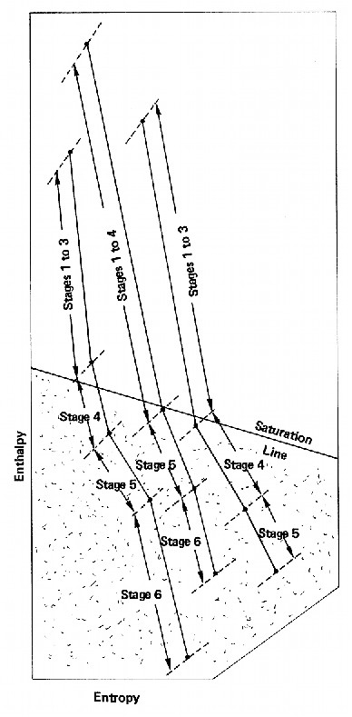
Introduction
Steam condenses into fog of droplets in LP turbine
High losses in nucleating stage
Droplet size information required to predict loss
Enthalpy
Measurements taken by P.T. Walters
Entropy

Slide 3
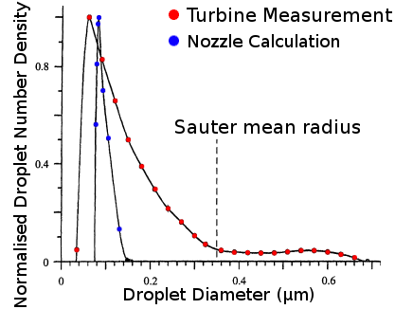
Broad Droplet Size Distributions
Hypothesis
Caused by unsteady wake-chopping effects

Slide 4
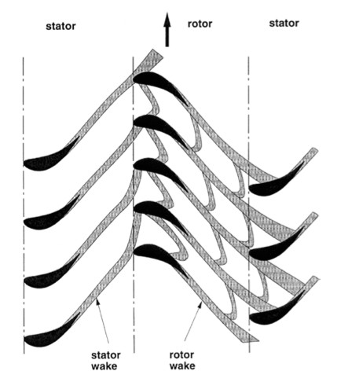
Previous Work
Gyarmathy & Spengler 1974
Total temperature fluctuations observed in exit flows
Bakhtar & Heaton 1988
Estimation of effect on droplet sizes by statistical model
Guha & Young 1994
Refined the statistical model using Lagrangian style nucleation and droplet growth calculations
Petr & Kolovratnik 2000
Compared statistical calculations to measurements for a 200 MW LP turbine

Slide 5
Numerical Scheme
TBLOCK by John Denton
Dedicated turbomachinery gas flow solver
Steady and unsteady calculations
Dual time stepping
Viscous effects using body force model
Turbulence using mixing length model
Steam properties included in lookup tables
Based on Virial Equation of state truncated at 2nd term
Accurate up to 5 bar
Poly-dispersed droplets treated by moments

Slide 6
Validation: Unsteady Nozzle Calculations
Supercritical heat addition from condensation causes unsteadiness
Asymmetric mode possible in nozzles with low expansion rates
Observed in moist air experiments
True time step must be less than ~1 μs

Slide 7
Validation: Unsteady Nozzle Calculations

Slide 8
Q3D Calculation for a Two Stage LP Turbine
Final stages based on model turbine geometry
Perfect gas calculation used to create Q3D geometry at mid span
Compare steady and unsteady calculations
Steady calculation averages the variables in a plane between the rows

Slide 9
Q3D Results: Wakes Entropy Contours for a gas calculation
Contours of exp(-Δs/R)

Slide 10
Q3D: Fluctuating Nucleation Rate

Slide 11
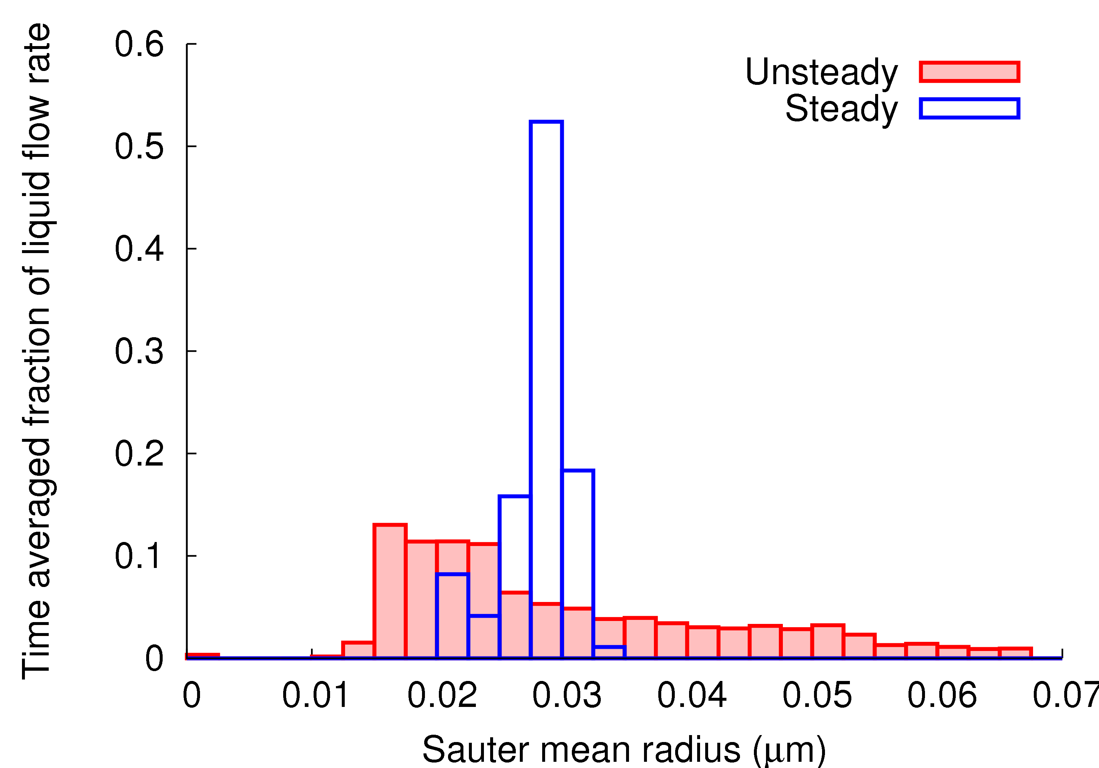
Q3D: Droplet Sizes Nucleation in Final Row
T_{0, Inlet} = 453 K

Slide 12
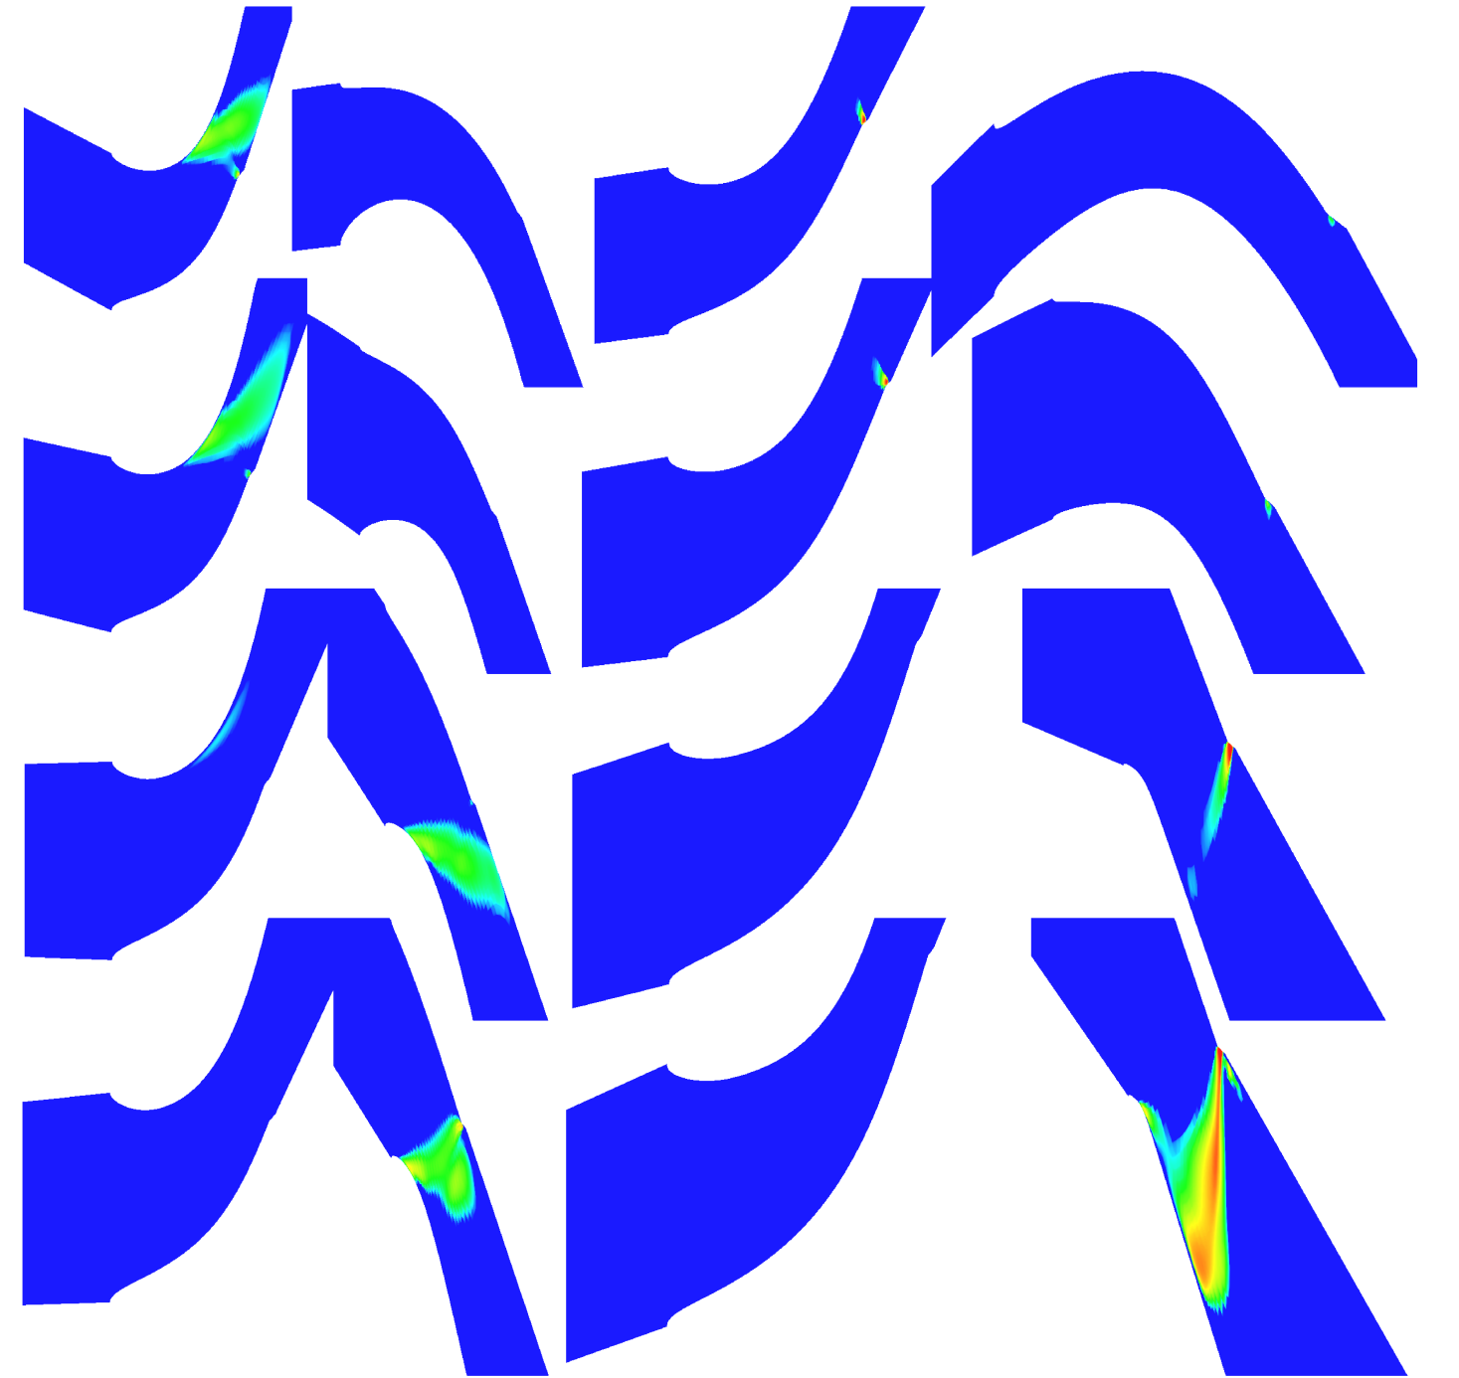
3D Two Stage Turbine: Nucleation
¼ span
½ span
¾ span
Near tip

Slide 13
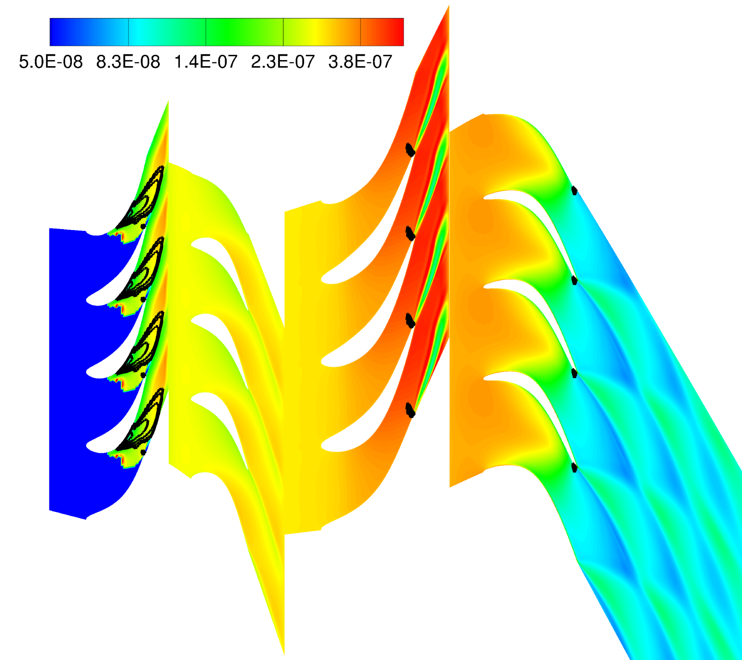
3D: Droplet Sizes at ½ Span Droplet size contours for steady calculation

Slide 14
3D: Droplet Sizes at ½ Span Size contours for unsteady calculation

Slide 15
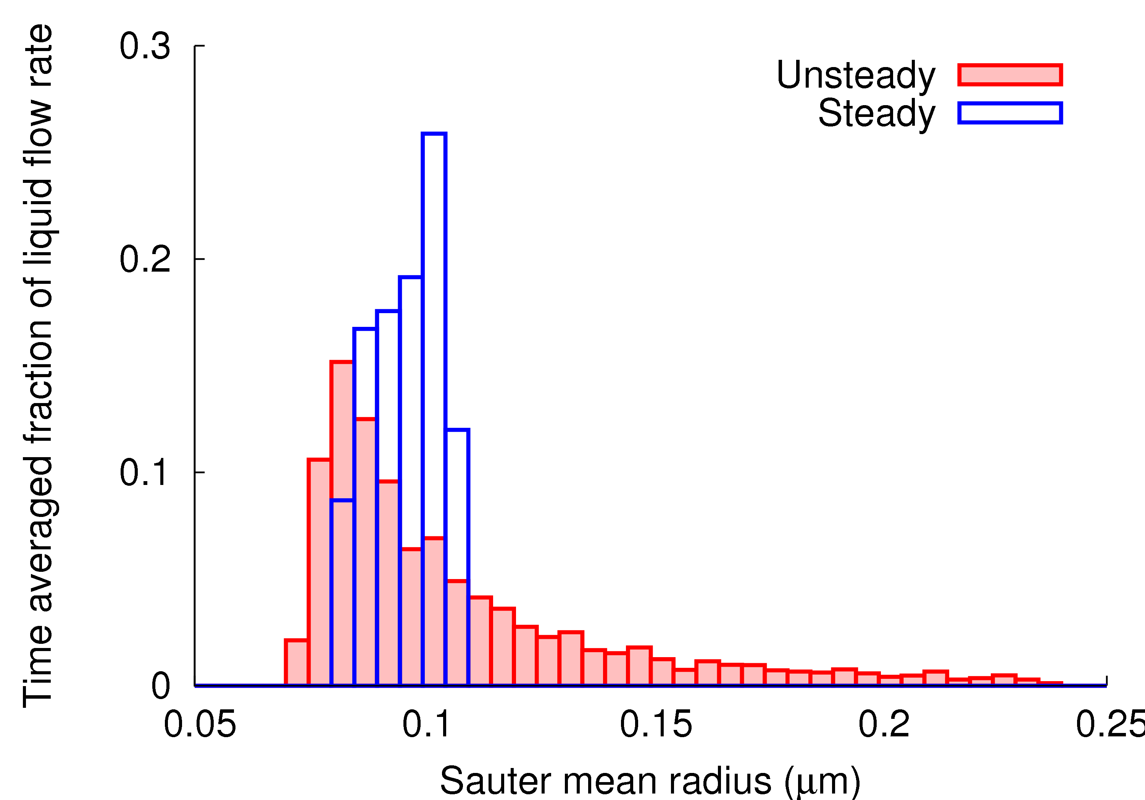
3D: Droplet Sizes at ½ Span

Slide 16
Summary / Conclusions
Unsteady wake segmentation clearly has a significant impact on the droplet spectra
2-stage Q3D calculations indicate a strong dependence on inlet superheat
Full turbine calculations, however, might not show the same sensitivity due to unsteadiness generated by upstream blade rows
3D unsteady calculations for a 5 stage machine are now within easy reach (anticipated run time: ~8 hrs on 25-core cluster)
Wakes downstream affect the growth of droplets
Hot wakes may cause secondary nucleation in later stages
Further calculations with more rows required to confirm the importance of wake chopping

Slide 18
3D Contour Plots
½ Span surface
Streamlines

