Slide 1
A Massively Parallel Incompressible Smoothed Particle Hydrodynamics Simulator for Oilfield Applications
Paul Dickenson^{1,2}, William N Dawes¹
¹CFD Laboratory, Cambridge University Engineering Dept, Trumpington St, Cambridge, UK, CB2 1PZ
²Schlumberger Cambridge Research, High Cross, Madingley Road, Cambridge, UK, CB3 0EL

Slide 2
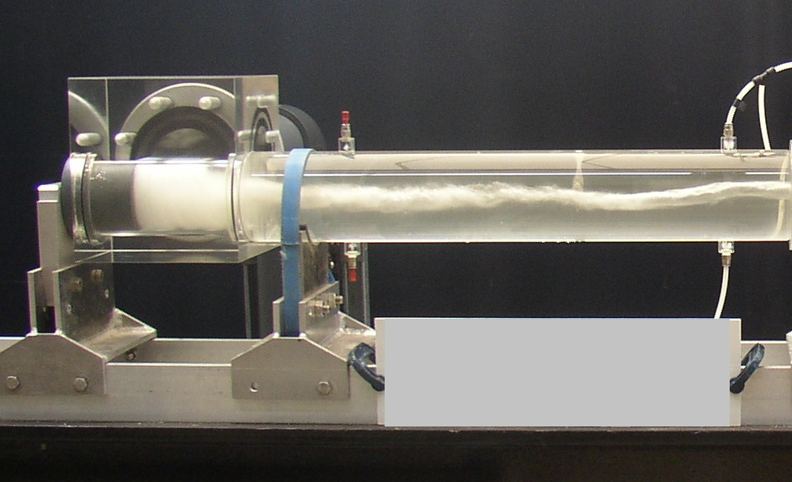
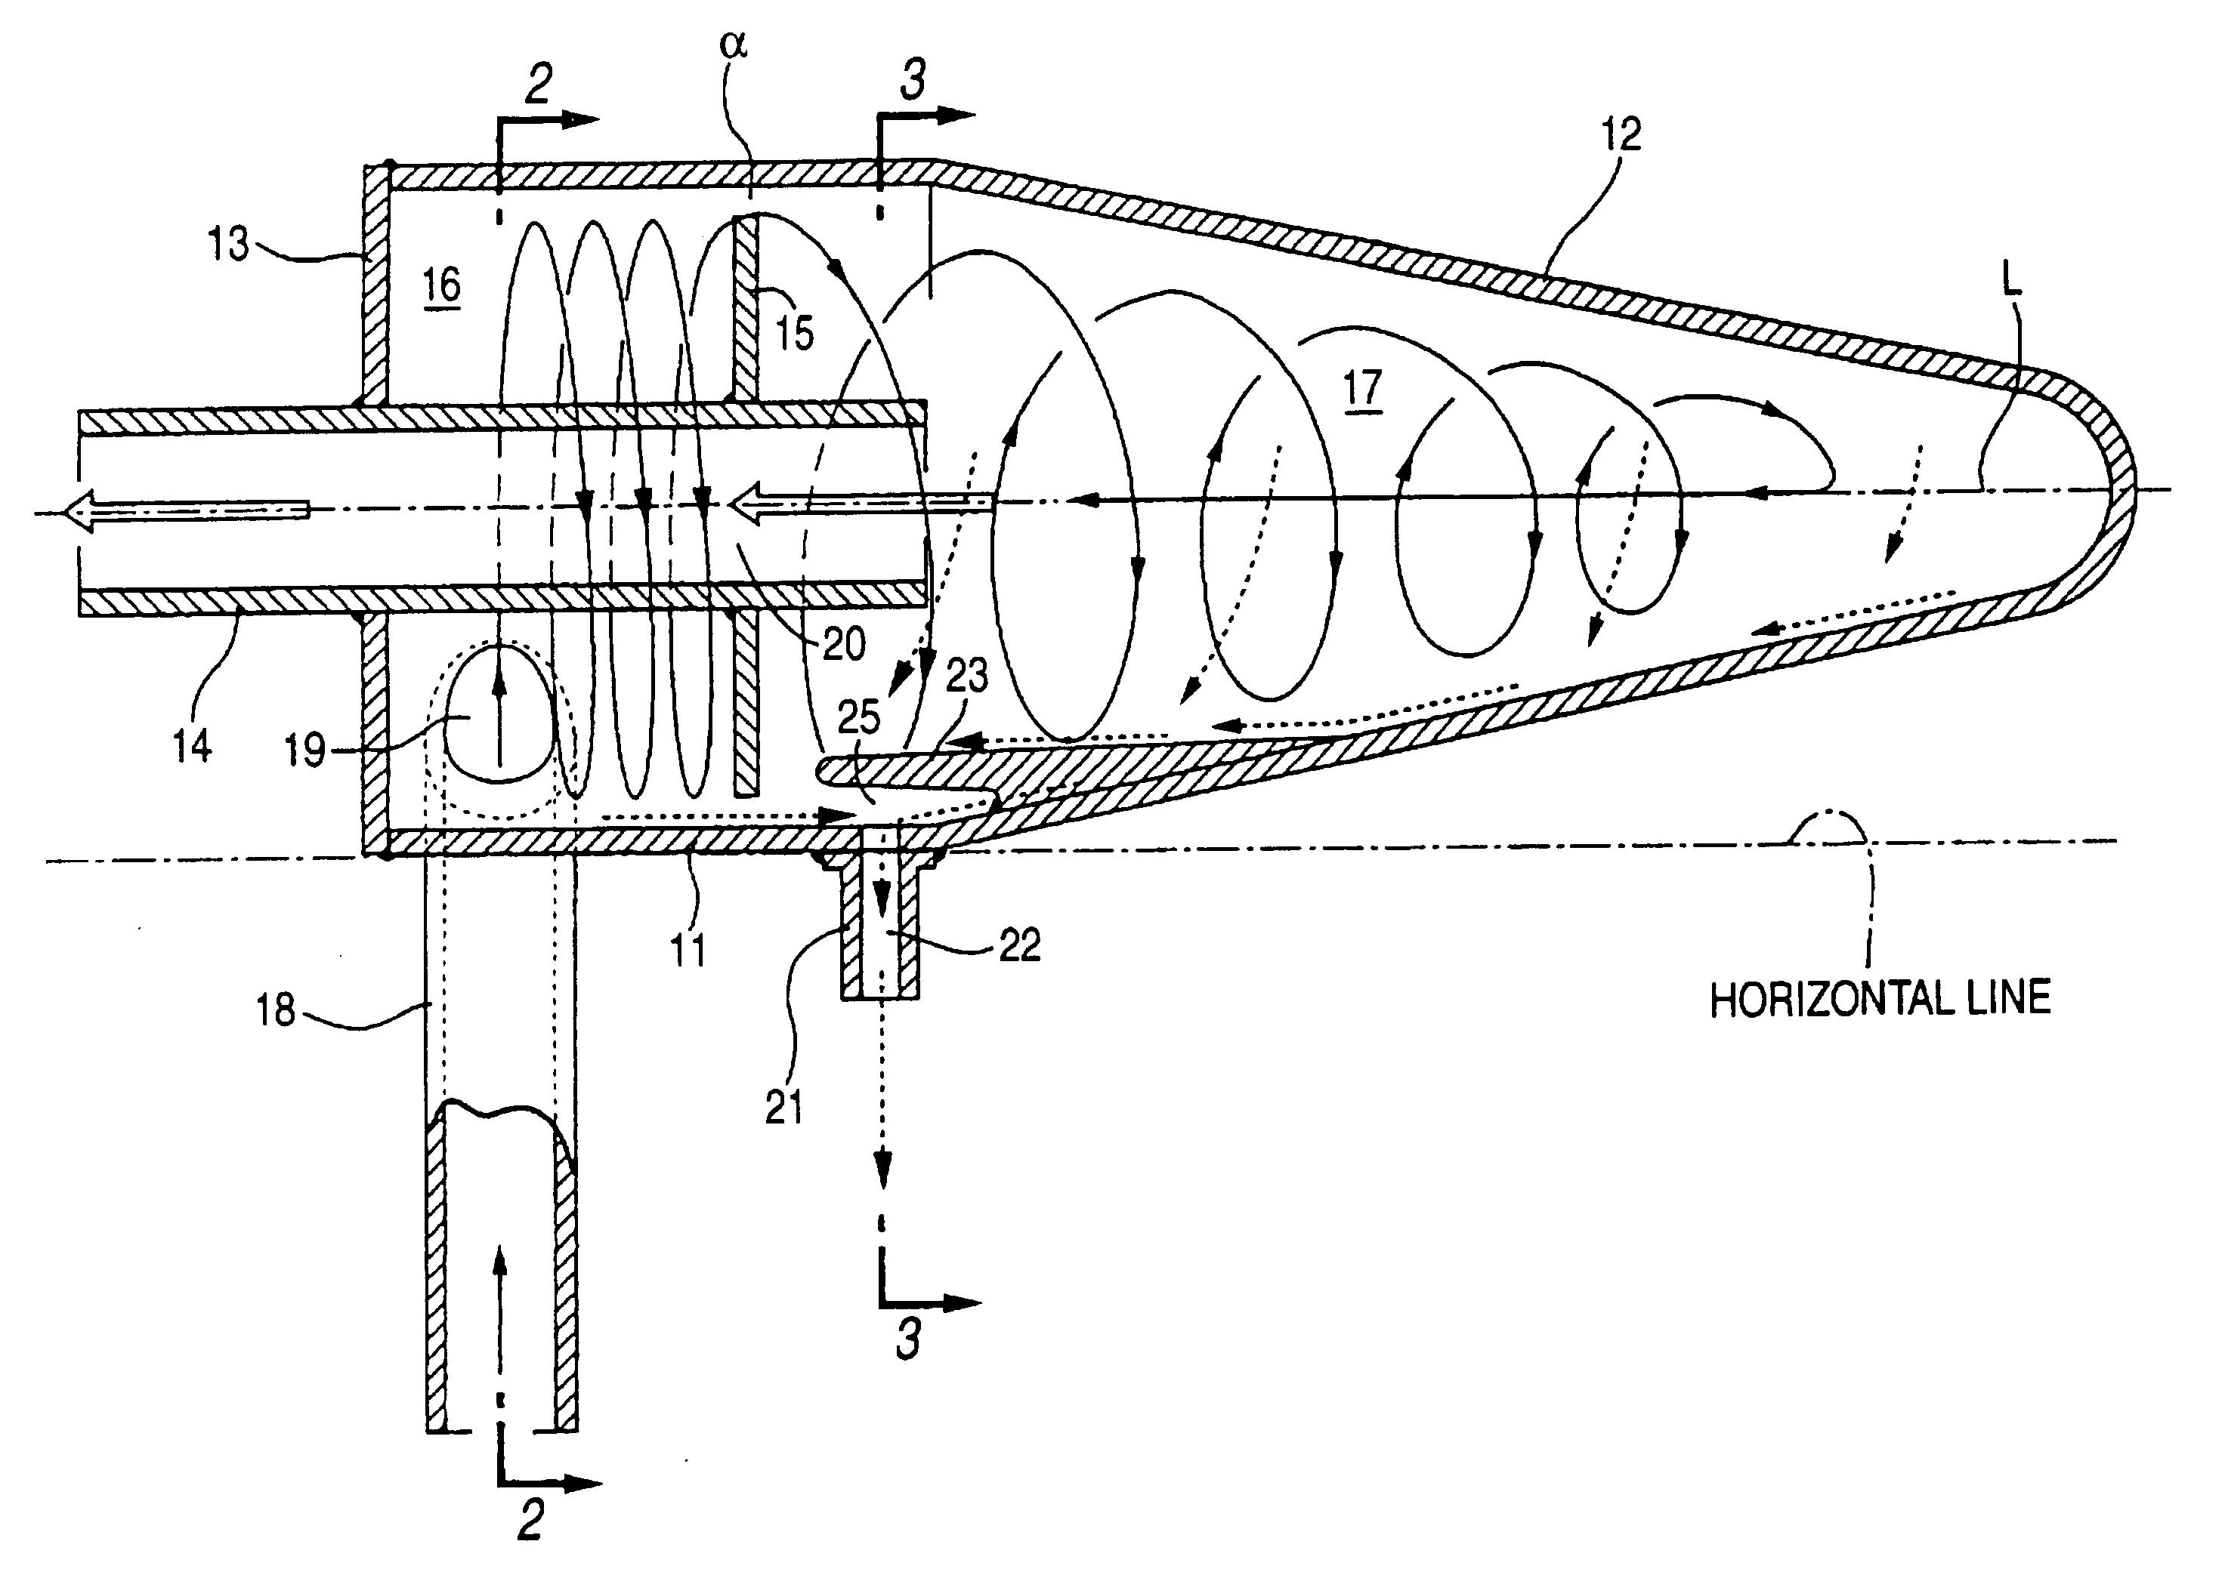
Introduction
Multiphase flows are important to oil and gas industry
Multiphase CFD can improve our understanding
Multiphase CFD remains underdeveloped
Smoothed Particle Hydrodynamics is good fit to many oilfield problems but significant scope for development
Rotating gas-liquid flows of particular industrial importance

Slide 3
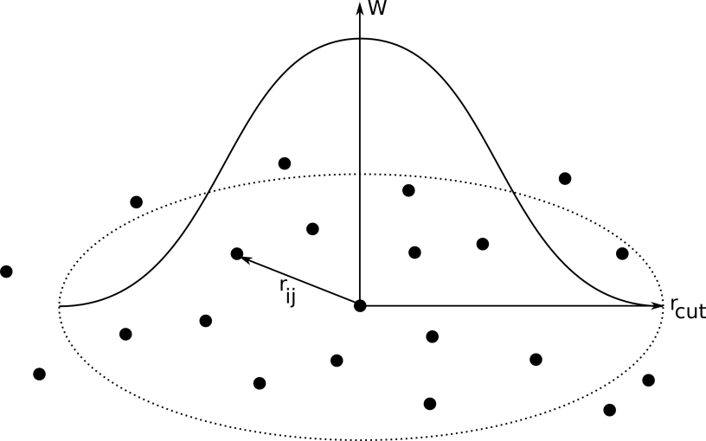
Smoothed Particle Hydrodynamics
Fully Lagrangian meshless particle method
Fluid properties distributed over points with kernel functions
Topology changes and free surfaces
Small volume of dominant fluid
Particles can have history - eg shear history
Expensive for simple problems, compares well for complex
Immature method – restricted by computational cost
Weakly Compressible and Incompressible Formulations

Slide 4
Resource Estimation
Consider typical Rotating Flow Test Case
Diameter 0.1m, length 1m
5mm resolution → 1-3 hours on single CPU
1mm resolution → 3-29 days on single CPU
Parallel computing required
....and using incompressible formulation
Dickenson, P; 2009; “The Feasibility of Smoothed Particle Hydrodynamics for Multiphase Oilfield Systems”;
Seventh International Conference on CFD in the Minerals and Process Industries; Melbourne 2009

Slide 5
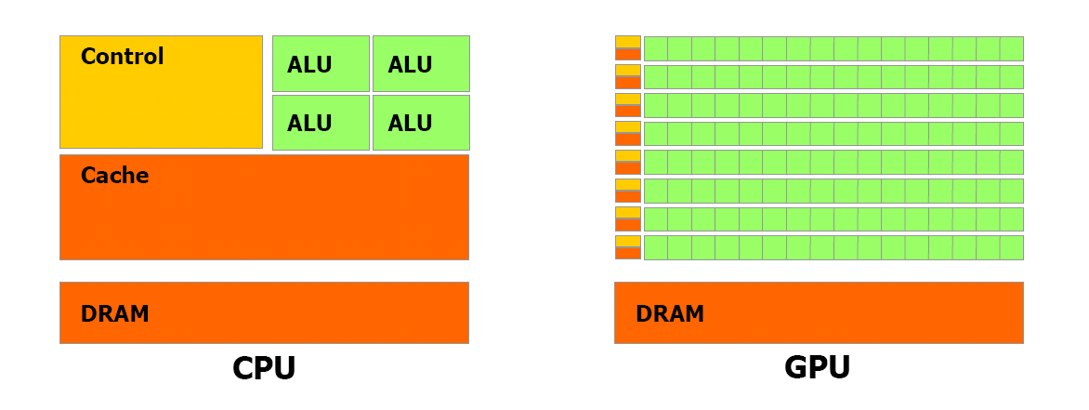
Massively Parallel Computing: GPU
Device-host operation
More ALU
Parallel at element scale
Limited Memory
SLOW
Good match to SPH EoM calculation
  Simple data structures
  High ratio of computation to memory
Massively Parallel WCSPH exists → up to 50x speedup
ISPH challenges → set up and solve PPE matrix problem

Slide 6
SPHIG Code Structure
All significant computation on GPU
Minimal data transfers

Slide 7
Solving the PPE
Pressure Poisson Equation
Reduces to a matrix problem
Matrix A is large but very sparse
Need to solve on GPU → minimise data transfers
Sparse matrix storage → minimise memory use
BiCGSTAB Sparse matrix linear solver for GPU
  Speed IT from vratis.com
Input matrix in Compressed Sparse Row format

Slide 8
PPE Set-up (1)
Must generate matrix on GPU → minimise data transfers
Generating matrix in CSR format is inherently serial
Write entirely new solver or create compatible parallel format
 | 1.0 | 1.4 | 0.0 | 3.0
 | 0.0 | 1.0 | 0.0 | 0.0
 | 0.0 | 0.0 | 1.0 | 5.2
 | 7.1 | 0.0 | 0.0 | 1.0
vals = [ 1.0 1.4 3.0 1.0 1.0 5.2 7.1 1.0]
cidx = [ 0 1 3 1 2 3 0 3 ]
ridx = [ 0 3 4 6 8 ]

Slide 9
PPE Set-up (2)
New pCSR format developed for massively parallel matrix generation
Fixed number of elements included per row
Padded with existing zeros so back-compatible with CSR solvers
Patent App GB1105576.1
SPHIG: one thread per row
 | 1.0 | 1.4 | 0.0 | 3.0
 | 0.0 | 1.0 | 0.0 | 0.0
 | 0.0 | 0.0 | 1.0 | 5.2
 | 7.1 | 0.0 | 0.0 | 1.0
vals = [ 1.0 1.4 3.0 1.0 0.0 0.0 1.0 5.2 0.0 7.1 1.0 0.0 ]
cidx = [ 0 1 3 1 0 0 2 3 0 0 3 1]
ridx = [ 0 3 6 9 12 ]

Slide 10
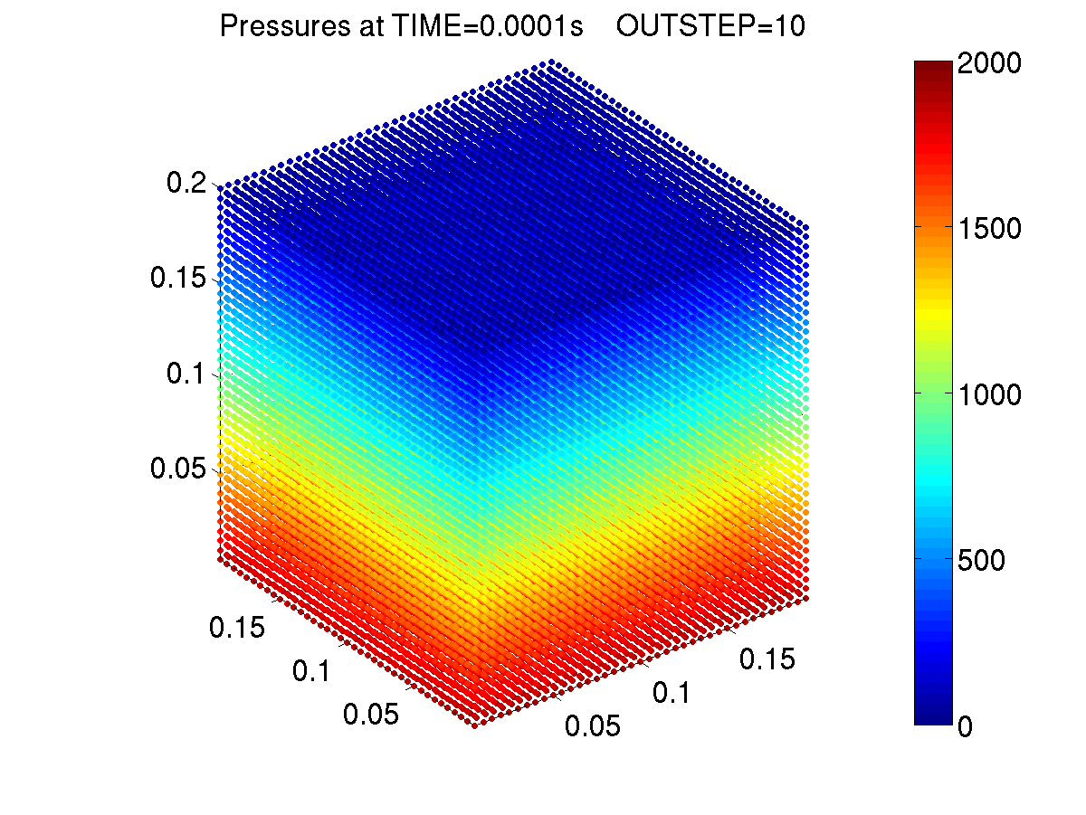
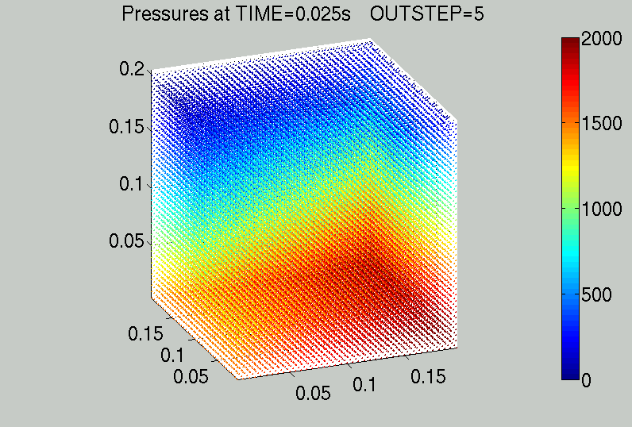
Results
Hydrostatic
Inclined Hydrostatic
Correct pressure distributions obtained within 3 time steps
Initial oscillation while particles move off grid
Much shorter duration than acoustic waves seen in WCSPH
Penetration of wall boundaries

Slide 11
Other Issues.....
Neighbour Searching
  Massively parallel implementation
Free surface boundary condition
  Detect by kernel truncation
  Set pressure to zero
Wall boundary condition
  Liquid particles fixed in space
  Impose normal pressure gradient condition
  Changes in progress.....

Slide 12
Conclusion
All ISPH components implemented for GPU computing
Pressure Poisson Equation generated and solved on the GPU
Maximum number of particles limited by significant GPU memory required to store the PPE matrix
Boundary conditions are challenging
Massively parallel ISPH is achievable but more work is required before complex problems can be simulated

Slide 13
Acknowledgements
Jointly funded by EPSRC and Schlumberger Cambridge Research
Thanks to Bill Dawes, PhD Supervisor
Thanks also to Wei Jian, Chris Lenn, Gary Oddie, Richard Mills, Mike Ford, Paul Cleary

