Slide 1

Vertical Axis Wind Turbine Noise
Charlie Pearson
Dr. Will Graham
Dr. Tamás Bertényi
Notes:
Charlie Pearson
1st year PhD

Slide 2
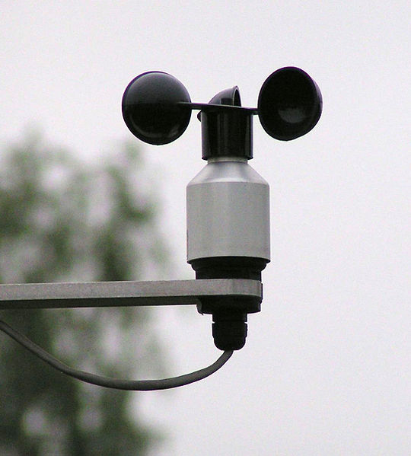
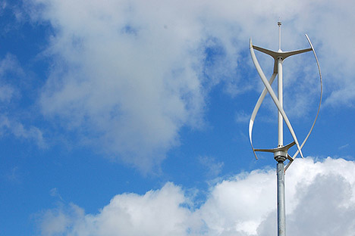
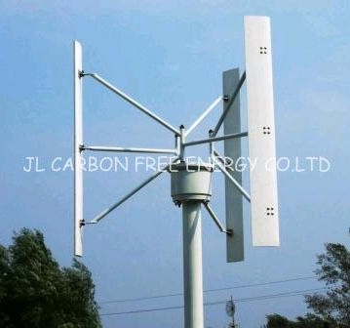
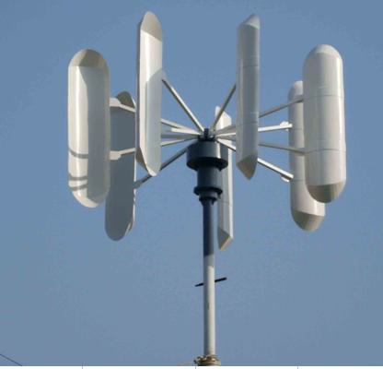
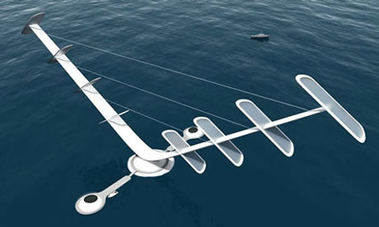
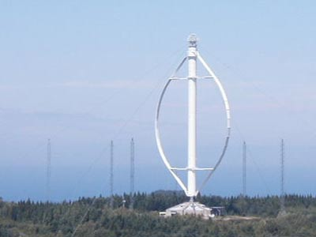
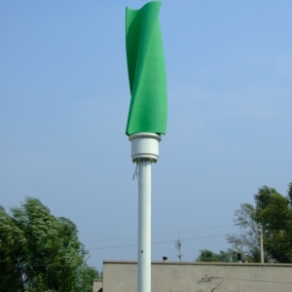
What is a VAWT?
Drag Type
Lift Type

Slide 3
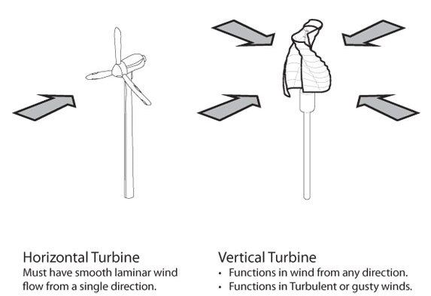
Why VAWTs?
Ideal for built environment…

Slide 4
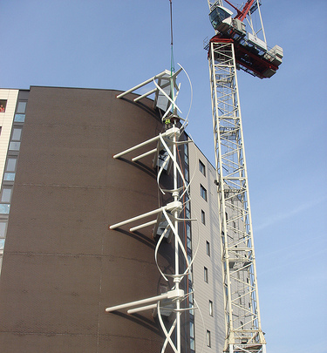
Built Environment Application
Issues:
Turbines are in close proximity to people.
Noise is a potentially significant problem
Objectives:
Identify dominant mechanisms of noise generation.
Investigate possible methods for reducing radiated sound.
Notes:
Turbine on your house or your office → noise will be a problem
What is the dominant source of noise on a VAWT
At the moment the noise mechanisms are very poorly understood
No detailed experimental measurements have been made.
How might we reduce that noise?

Slide 5
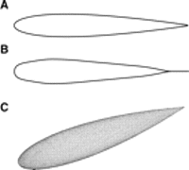
How does a lift-type VAWT work?
V∞
Angle of attack, α
V∞
V∞
V_{Rel}
F_{Lift}
V∞
V_{Blade}
F_{Lift}
F_{Tang.}
V_{Rel}
F_{Tang.}
F_{Tang.}
V∞
V_{Blade}
F_{Lift}
V_{Rel}
V_{Blade}
Key Parameter: Tip Speed Ratio
TSR= Blade speed / Wind Speed
Notes:
In order to understand the noise generation we need to first understand how a VAWT produces torque…
1
Angle of attack generated by combination of wind speed and blade speed
Produces a tangential force and therefore torque
2
Varies as a function of blade position
3
The magnitude of the variation is dependent on the TSR
4
5
The variation is greater at lower TSR
Even at higher TSR the blades are likely to go into stall
Key conclusion is that the blade loading is fundamentally unsteady.

Slide 6
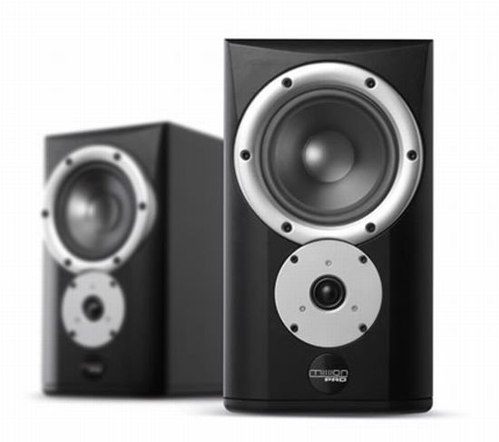
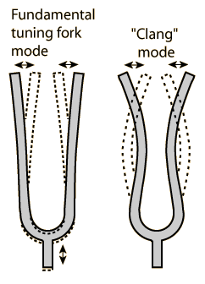
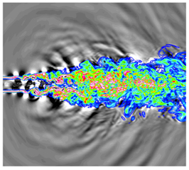
Where does noise come from?
Kinetic energy is converted into acoustic energy by three mechanisms:
By forcing the mass in a fixed region of space to fluctuate, e.g. a loudspeaker in a large baffle.
By forcing the momentum in a fixed region of space to fluctuate, e.g. a solid object vibrating after being struck.
By forcing the rates of momentum flux across fixed surfaces to vary, e.g. turbulent jet.
Definitions from MJ Lighthill, 1952, On Sound Generated Aerodynamically, Proc. R. Soc. Lond. A, Vol.267, 147-182
Jet noise image from: http://cms.tacc.utexas.edu/news/feature-stories/2011/reducing-jet-noise-by-controlling-turbulence/
Notes:
In order to understand why unsteady loads are important we need to look at how noise is generated…
Forcing the mass to fluctuate: Loudspeaker in baffle, pulsating sphere
Momentum fluctuation: Vibrating solid object, oscillating sphere
Momentum flux fluctuation: turbulent fluctuations
These are in order of strength (high to low) for low Mach number flows.
VAWTs operate at low Mach

Slide 7
Where does VAWT noise come from?
Dipole noise due to fluctuating blade loads dominates at low Mach number.
Need to know the blade loads in order to determine the noise analytically.
This presents some significant problems…
Notes:
Now the situation is becoming clearer…
Unsteady loads drive the sound field
If we know the blade loads then we can determine the sound field
How do we go about calculating the sound field?
It is pretty tricky

Slide 8
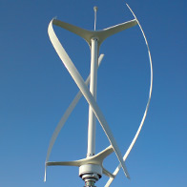
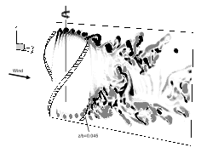
CFD Modeling?
Flow is fundamentally unsteady
Flow is 3D
Flow is turbulent and has a wide range of length and time scales
Flow is VERY complicated!
Difficult to determine the most significant noise sources.
Image from Scheurich, Fletcher and Brown, (2010), The influence of Blade Curvature and Helical Blade Twist on the Performance of a Vertical Axis Wind Turbine, 48th AIAA Aerospace Sciences Meeting, Orlando, USA
Notes:
First attempt might be to try CFD…
As we have seen the flow is:
Unsteady
Effect of blade tips make the flow very 3D in nature
To resolve all acoustic wavelengths we need to have high resolution on the blades – TIME AND SPACE
Flow is complex!
Unless we can perform very high fidelity simulations we are not likely to get an accurate picture of the sound field.

Slide 9
An alternative approach...
Use analytic acoustic model for moving point source.
Guess the blade loads
  Sinusoidal variation with azimuth?
  Blade/wake interactions?
  Dynamic Stall?
Predict the resulting sound field
Far field:
Near field:
MV Lowson, (1965), The Sound Field for Singularities in Motion, Proc. R. Soc. A, Vol.286, 559-572
4. Identify key characteristics of sound field for comparison with experimental data.
Notes:
Use moving singularity model developed by Lowson.
Keeps the key components while avoiding unnecessary complication
Key component is the fluctuating force component in the far field term
Set up the rotor geometry and the observer location
Guess the blade loads

Slide 10
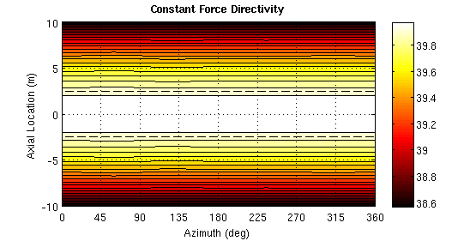
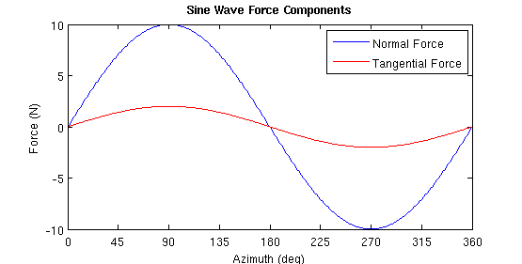
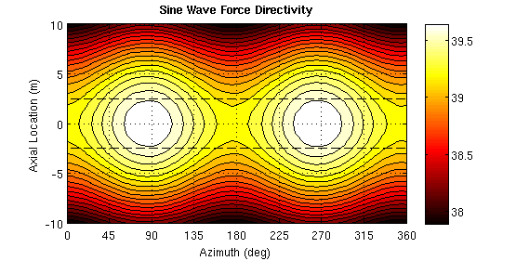
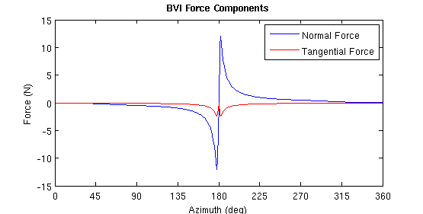
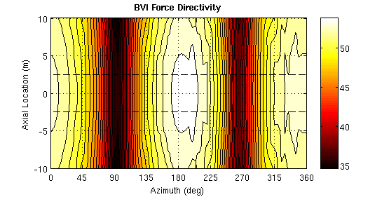
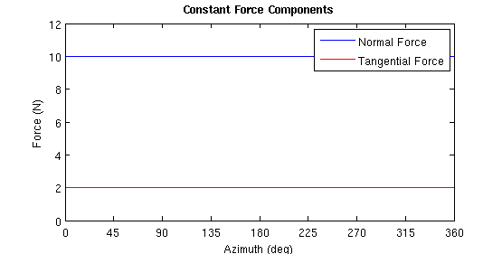
Loading Profiles Tested
Define normal and tangential blade loads as a function of azimuth:
Constant Load
Sine Wave
Blade Vortex Interaction
Zero wind load
Constant drag load
Loads you would get if there were no blade/wake effects.
Load due to the blade passing close to a coherent vortex.
Notes:
Constant load:
Good for calibration
Sinusoidal load:
Sort of loading you would get if there were no wake interactions
Good representation of the upstream half of the rotor
BVI load:
Loading profile is dependent on the strength of the vortex and the blade/vortex separation
Strongly directional sound field

Slide 11
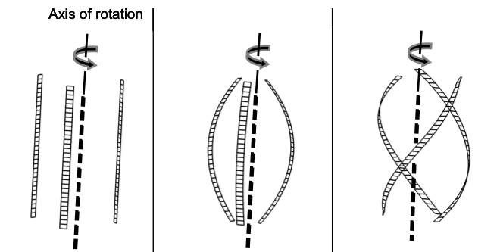
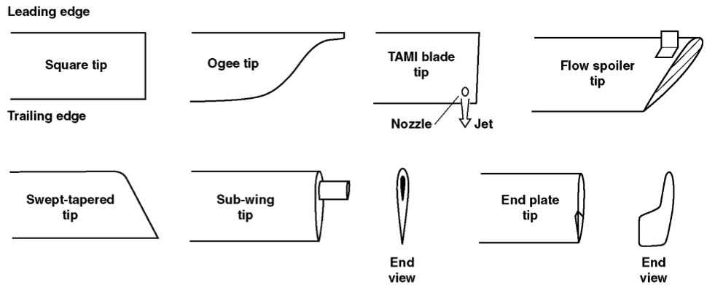
Experiments
Use acoustic array in Markham wind tunnel to locate dominant noise sources.
Investigate parameters for noise reduction
  Blade tip shape
  Spoke geometry
  Variable radius
  Blade sweep / helical blades
Notes:
Measure the sound field using the acoustic array in the Markham tunnel.
Based on results of initial measurements, investigate some design parameters to see if the noise can be reduced.
Blade tips: change structure of the rotor wake
Spoke geometry: cylindrical / aerofoil
Radius: Impact on tip vortices
Helix: Twist spreads load around rotor, smoother loading?

Slide 12
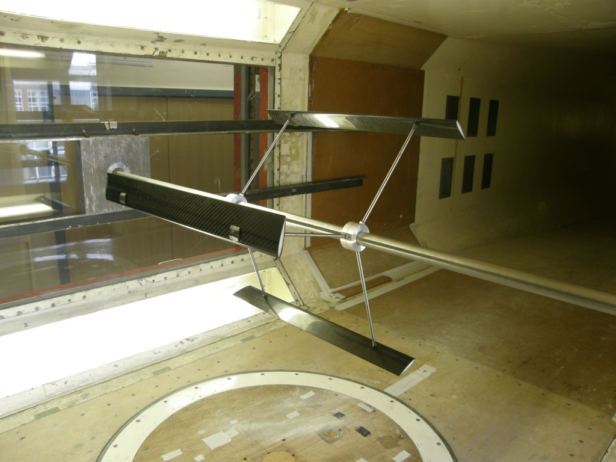
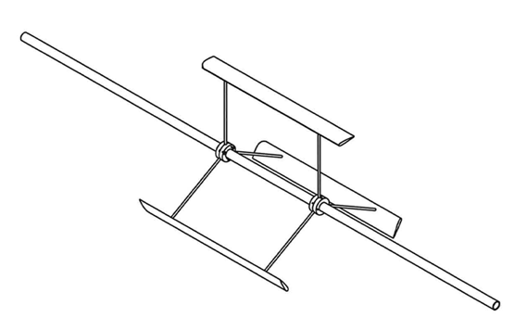
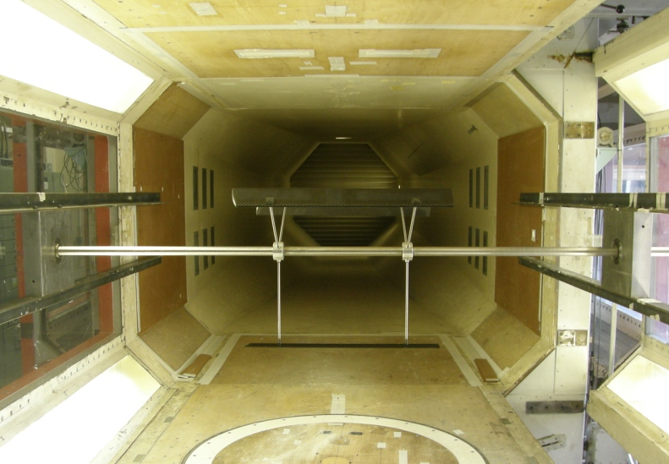
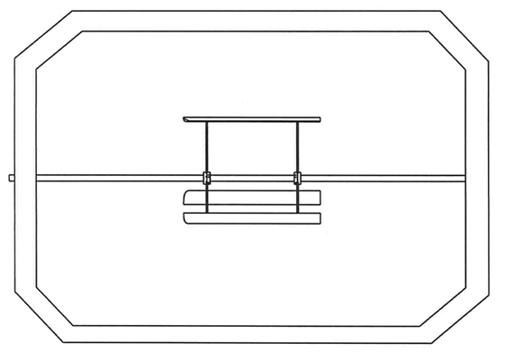
Notes:
3 Straight blades
Motor driven so we can control the speed more accurately
Measure the unsteady torque on the shaft.
Measure the sound field using the acoustic array

Slide 13
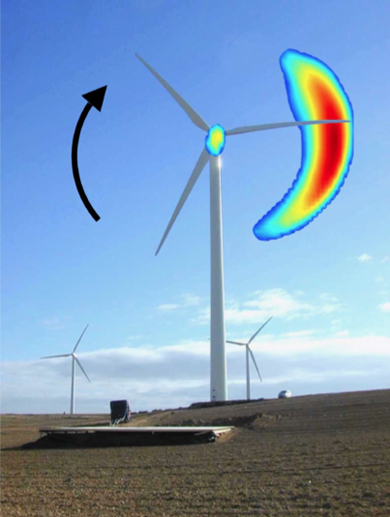
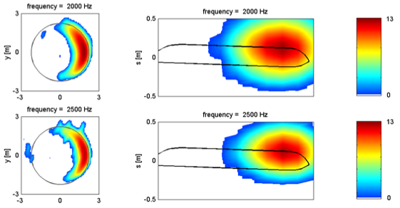
Array Measurements
Sijtsma, P (2004), Experimental techniques for identification and characterisation of noise sources, National Aerospace Laboratory NLR Report, NLR-TP-2004-165
Use phase relationship between signal received at multiple microphones.
Sijtsma, P, Oerlermans, S and Holthusen, H (2001), Location of Rotating Sources by Phased Array Measurements, NLR-TP-2001-135
Notes:
Acoustic array consists of multiple microphones which simultaneously record the sound from an object.
By comparing the signals at each microphone it is possible to estimate the source location.
We want to attempt to do for VAWTs what Peter Sijtsma has done for HAWTs.

Slide 14
Plan of action
Measure sound field in the wind tunnel using acoustic array.
Compare results with computer model predictions.
Investigate dominant noise sources in detail.
Inform the design of quieter VAWTs
Questions?

