Slide 1
High Temperature Condensation Particle Counter (CPC)
Jeng K. Rongchai
kr298@cam.ac.uk
FETE Conference
21 July 2011

Slide 2
Outline
Background, Motivations & Objectives
Modelling
Experiment
Conclusions

Slide 3
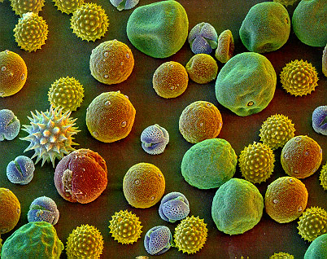
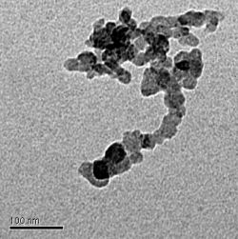
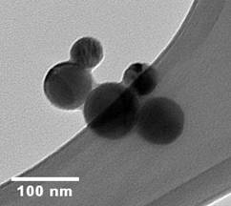
Airborne Particles
Fine dust particles
Smoke particles
Atmospheric aerosols
Soot particles
Size ranges from
a few nanometres to a few microns

Slide 4
Condensation Particle Counter
CPC measures NUMBER concentration of aerosols particles.
CPC
CPC
CPC

Slide 5
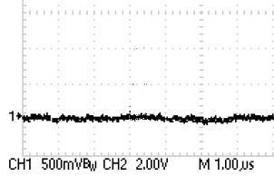
Typical CPC
Pump
Optical Trap
Optical Counter
Light source
Detector
Condenser
(10 ˚C)
Detector Signal
Butanol
Filtered air
Saturator
(35 ˚C)
Nanoparticles
Sample

Slide 6
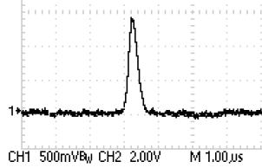
Typical CPC
Light source
Detector
Condenser
(10 ˚C)
Detector Signal
Butanol
Filtered air
Saturator
(35 ˚C)
Nanoparticles
Sample

Slide 7
CPC : Limitations
may affect
particles’ morphology and Concentration
CPC
150 °C
Cooling
35 °C
Complexity
Slow time
response
Cost

Slide 8
Motivation : High Temp CPC
CPC
150 °C
Cooling
High Temp
could improve/replace the regulated particles measurement systems

Slide 9
Objectives
Theoretical model
Design & Build low-temp Butanol CPC
High-Temp CPC
Condenser
Fast time response
~ 200 °C
Saturator
Exhaust particles

Slide 10
Modelling
COLD
COLD
Mass
Heat
Hot
D_{v} < α
Saturated Vapour-laden Hot uniform flow

Slide 11
Particles growth Activation
Kelvin’s Equation
Condenser Wall
S =2.5
Condenser Wall
S =2
S=1.5
S=1
diameter dk

Slide 12
Choice of Liquid
Di-ethylhexyl Sebacate (DEHS)
Mass diffusivity in air (D_{v} ) = 0.063 cm²/s
Air Thermal diffusivity (α) = 0.51 cm²/s
D_{v} < α
Liquid @ room temperature
190 °C
High Boiling point ~350°C
Non-toxic
DEHS
Saturator ~210°C

Slide 13
Saturation ratio
190°C
190°C
2.2
2
1.5
1
210 °C
210 °C
DEHS Saturated
uniform flow

Slide 14
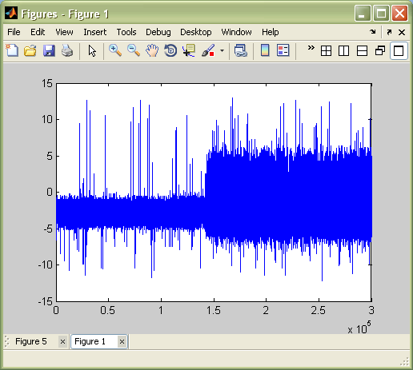
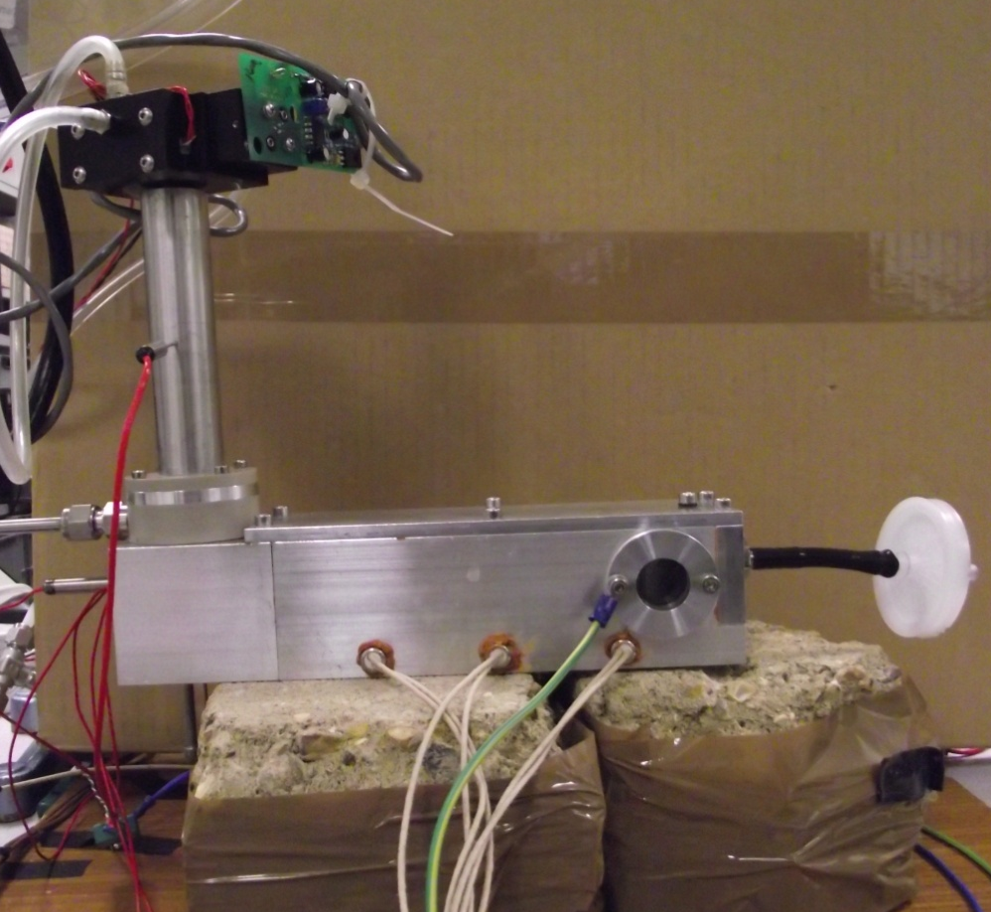
Into Practice : Low-Temp Butanol CPC
Filtered air
Ambient particles
mV
Optical Counter
Condenser
Step increase in particle concentration
Filtered air inlet
Time(s)
Aerosol inlet
Saturator

Slide 15
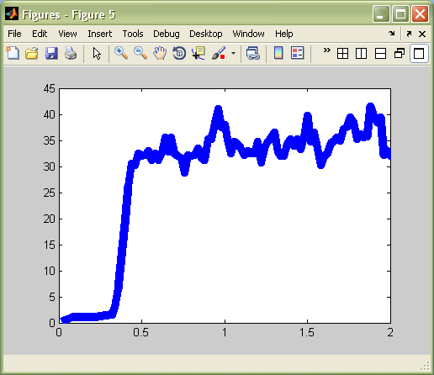
Transient Measurement
Particles
T₁₀₋₉₀ ~ 50ms
< common CPCs* ~ 170 ms
Will be the same for high temperature
Time (s)
* TSI 3025

Slide 16
Conclusions
Low-Temp Butanol CPC built from scratch
Fast Time response (50 ms) was observed
Promising simulations for DEHS high-Temp CPC
Next step : Test DEHS CPC
If successful, could change the current regulated exhaust particles measurement system.

Slide 17
THANK YOU

Slide 18
THANK YOU

Slide 19
Condensation - Nucleation Theory
Homogeneous Nucleation - in highly saturated condition
Heterogeneous Nucleation – exotic particles present
Equilibrium
diameter
Vapour
Equilibrium
diameter
Vapour

Slide 20
Velocity Profile
COLD
COLD
Hot
Saturated Vapour-laden Hot uniform flow

Slide 21
Particle size that can be activitated
190°C
190°C
8nm
10nm
13nm
210 °C
210 °C
DEHS Saturated
uniform flow

Slide 22
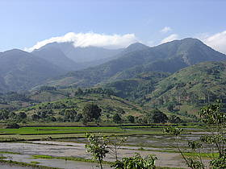
Importance
Car engine exhaust
Health Effects
Pollution
Policy making

Slide 23
Modelling
Supersaturated Region
Condenser Wall
Condenser Wall
Saturated Vapour-laden Hot uniform flow

