Slide 1

Shale oil extraction and CO2 sequestration by a novel method of hot gas injection
Michael Youtsos – Energy Group
Cambridge University Engineering Department
Supervisor: Prof. Nondas Mastorakos
Notes:
Hello, my name is Michael Youtsos and today I want to talk to you about injecting hot CO2 into underground reservoirs and how by doing that we can extract what’s known as Shale Oil

Slide 2
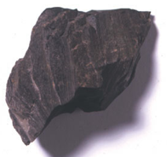
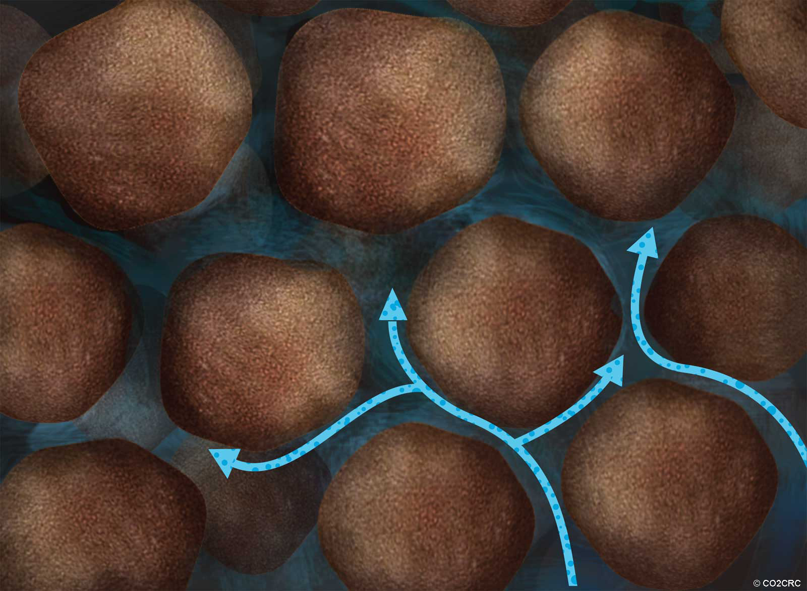
What is Shale Oil?
Shale rock contains organic material called Kerogen
When you heat it, Kerogen decomposes to Oil and Gas
O(10⁻⁶m)
There are about 2 - 4 trillion barrels worth of shale oil in the USA alone . . 400 years of oil supply!!
Notes:
SO FIRST I WOUL HAVE TO TELL YOU THAT SHALE ROCK, WHICH STORES SHALE GAS BTW, . . . .

Slide 3
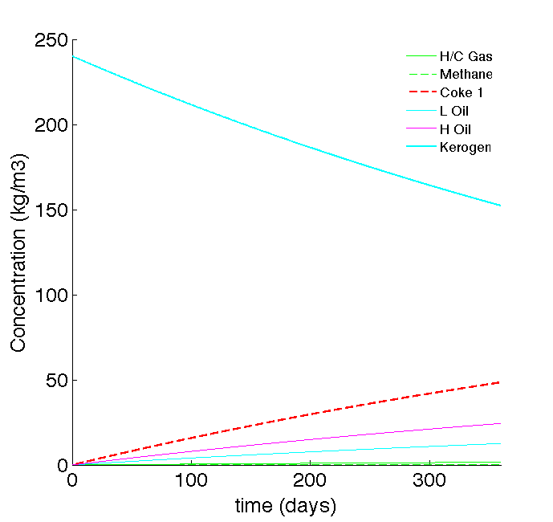
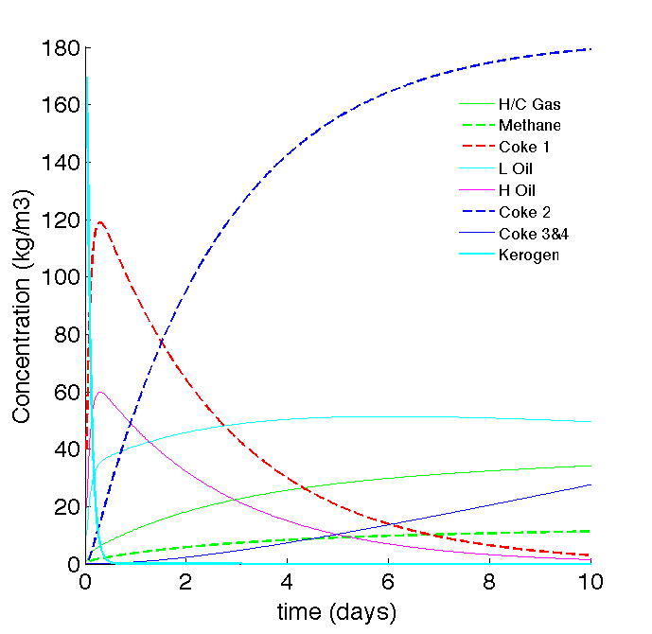
Reaction Mechanism [Burnham and Braun (1991)]
Kerogen + Energy→ Heavy Oil + Light Oil + Gas + Char
Heavy Oil + Energy → Light Oil + Gas + Char
Light Oil, Gas and Solid residue decomposition reactions…
543 K
643K
Notes:
So how does Kerogen become oiL? There is no one agreed upon mechanism!

Slide 4
Novel (simple) Extraction Technique
Inject hot, pressurized CO2 to heat shale underground (in situ heating)
Current inefficiencies of extraction have a lot to do with
  Large timescales for extraction due to conduction heating (3 – 5 years) [Fan et al. (2009), White et al. (2010)]
  Inefficient thermal waves due to conduction heating (Low EROI)
  Huge environmental costs (Retorting of Shale) [Brandt (2008)]
Gas injection may solve these issues:
  As a fluid it will travel relatively quickly through the reservoir
  It will carry the thermal wave with it [Jupp & Woods (2003)]
  It can be sequestered directly underground after heating
Notes:
So, what are we trying to contribute with this research?
And the reason we are trying to do that is . . . Current inneficies are mostly due to conduction heating: takes to long, wastes energy due to it’s thermal wave’s long tail and therefore v. env costly also!!

Slide 5

Governing equations [Chen et al. (2006)]
Multiphase flow in a reservoir: Oil and Gas
Darcy’s Law to find phase velocities – (each phase)
Mass conservation – (each phase)
Notes:
Now how to physically describe these underground processes?

Slide 6

Governing equations [Woods & Jupp (2003)]
Dynamic Pressure Equation – (liquid phases)
Reservoir Energy/Temperature equation – (all phases)
Ratio of specific heat capacity of fluids to that of solids
Notes:
Next we consider that these phases exist together on a microscopic grain level underground
Heat transfer rate on a grain level is so fast that we can assume that we have one energy equation

Slide 7
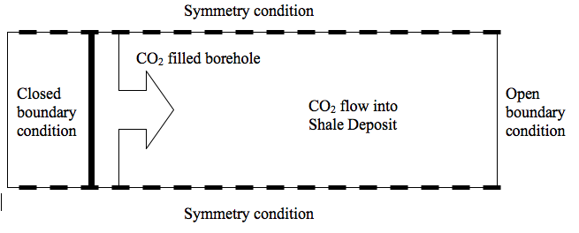
Problem Description
1D Cylindrical coordinates
Injected CO2: 230 bar, 573K
Reservoir: Porosity = 0.1, Permeability = 5mD,
Richness = 30 gal/ton, Pressure = 100 bar
Notes:
And this is what our problem now looks like
A 1D grid, discretized in cylindrical coordinates
Medium richness about 500 m undergroun! ---→ B/C;s and IC’s are our base case

Slide 8
Numerical Method
Discretized PDE’s and fed them as ODE’s to DVODPK
Second order upwind differencing for advection terms
Second order centered differencing for diffusion terms
Notes:
So we take our discretized PDES, which we have discretized as below, and feed them to the ODE solver DVODPK

Slide 9
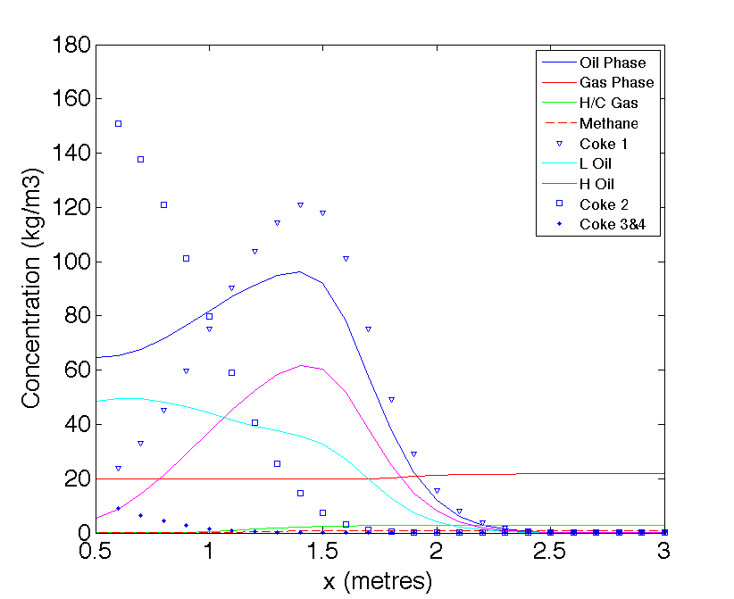
Base Case – 20 days of heating

Slide 10
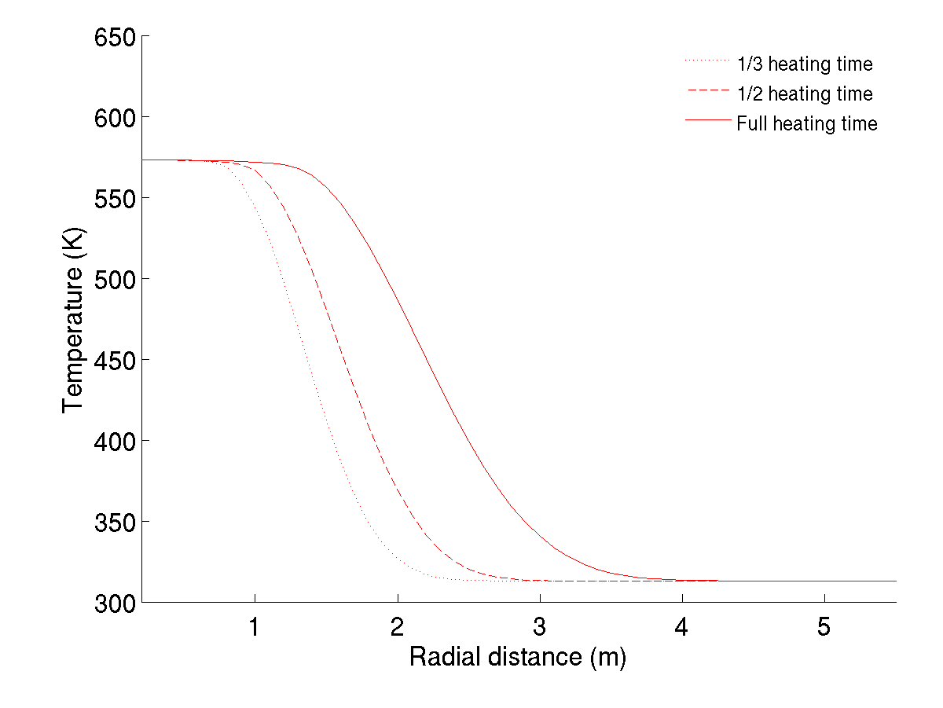
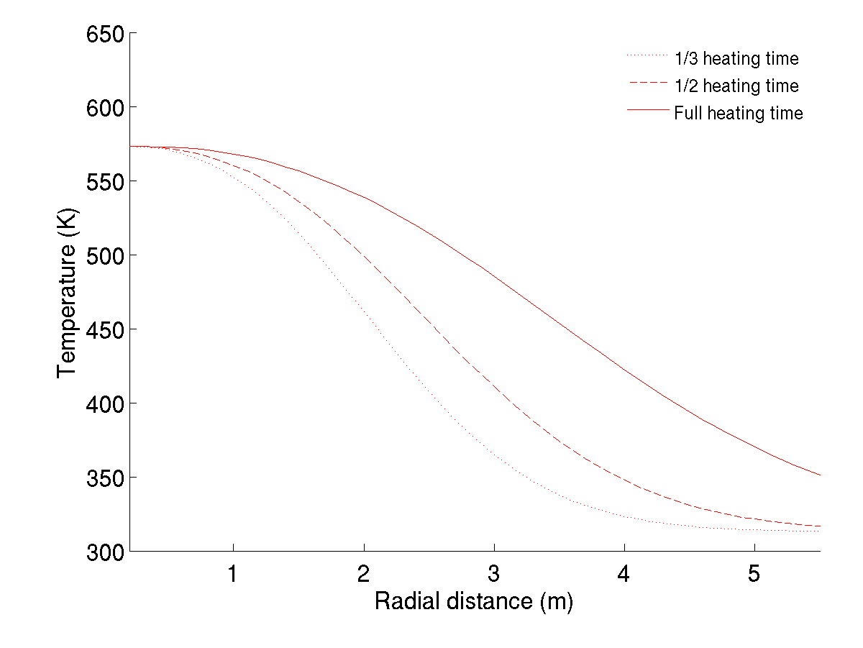
Base Case – 20 days of heating
Steep thermal profiles for gas injection (LEFT)
Long thermal tails for conduction (RIGHT)
Notes:
BUT THE INTERESTING STUFF IS OVER HERE

Slide 11
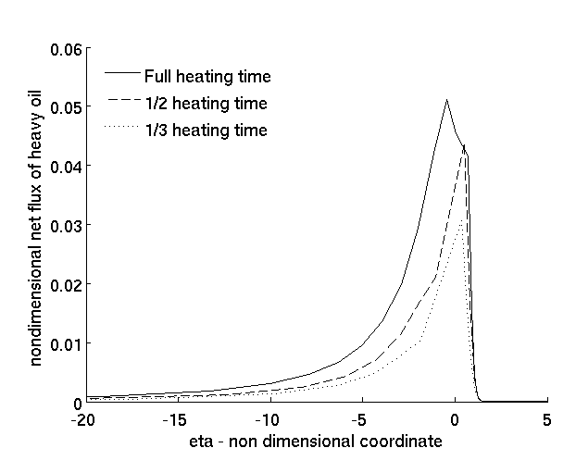
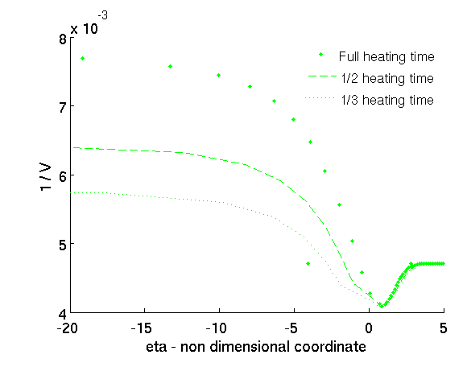
Base Case – 20 days of heating
Non dimensional flux of oil (LEFT) peaks at thermal wave front
[ Thermal wave speed ] / [ Fluid speed ] (RIGHT) minimum follows reaction / thermal front
Notes:
AND THERE”S A LOT TO UNDERSTAND FROM PLOTTING THESE TWO NON DIMENSIONAL VARIABLES AGAINST A NON DIMENSION COORDINATE ETA, WHICH MOVES WITH THE THERMAL WAVE
THERMAL AND REACTION FRONT ARE FOLLOWING EACH OTHER VERY CLOSELY - THERMAL WAVE SPEED IS NOT AFFECTED DOWNSTREAM, STAYS WITHIN REACTION WAVE

Slide 12
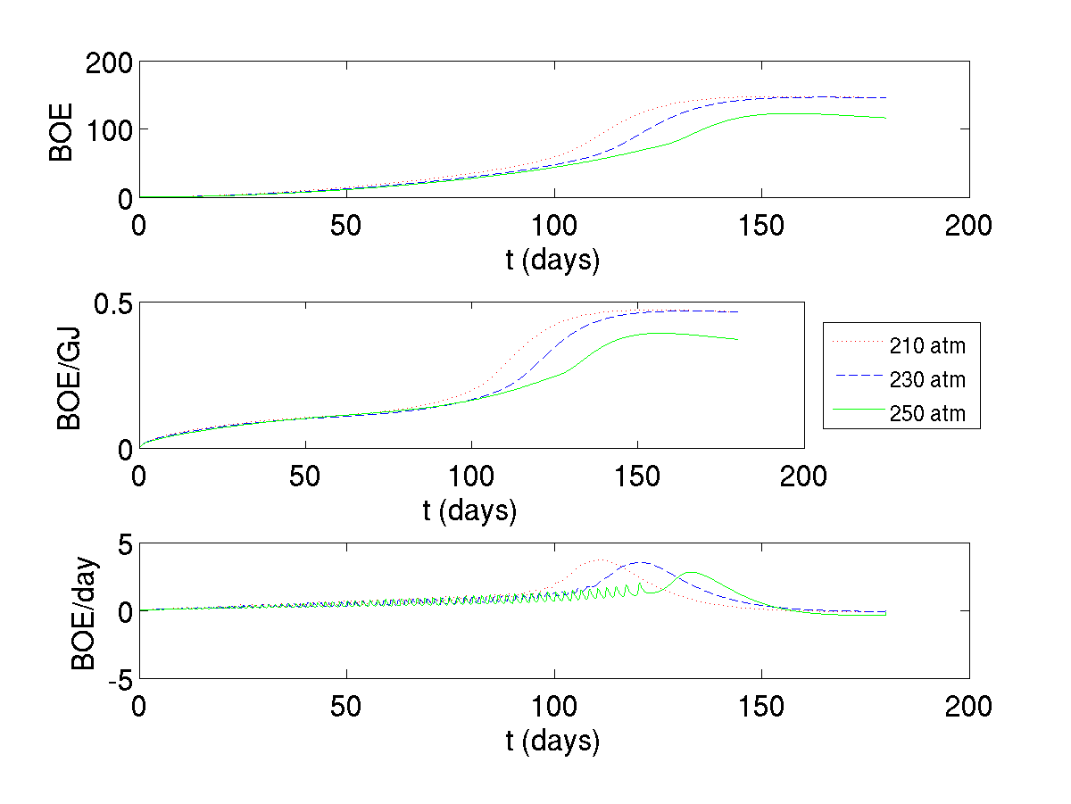
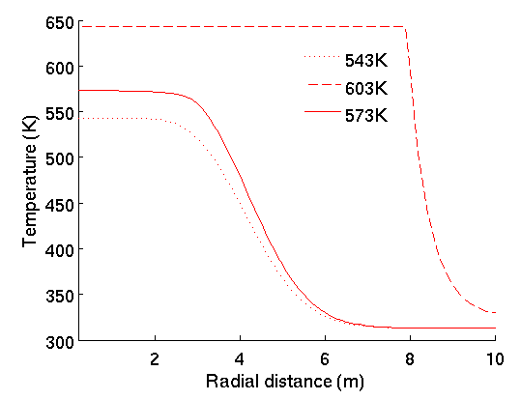
Temperature variations
Very high temperatures form strong convective wave
Lead to rapid heavy oil decomposition
Notes:
WHAT HAPPENS WHEN UP THE TEMP?? BETTER WAVE, TOO MUCH DECOMP
TOO LOW A TEMP, and NO DECOM
EFFICIENCY GRAPHS TELL THAT STORY AS WELL

Slide 13
Pressure variations
High pressures lead to quick extraction of oil but require high energy injection rates
Notes:
ON THE OTHER SIDE OF THINGS
BUT, AS THIS GRAPH SHOWS, IT WONT OFFSET THE EXTRA AMOUNT OF ENERGY THAT YOU WILL HAVE TO PUMP IN!

Slide 14
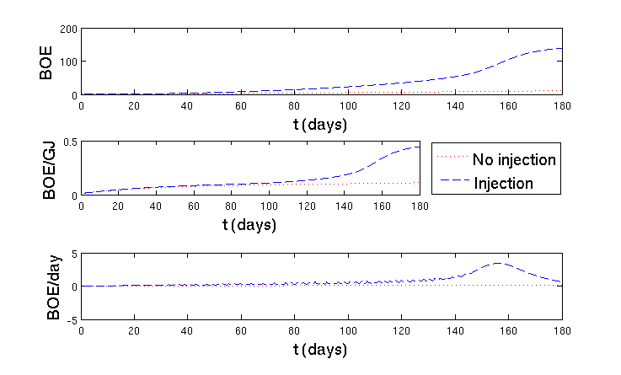
Thermal conduction vs. Gas injection
Efficiency graph: injection is more efficient (EROI 6:1), extracts oil quicker.
Notes:
SO FINALLY, here we are

Slide 15
Future Work
→ Performing a more detailed Sensitivity Analysis
→Lattice Boltzmann method to explore interaction of shale products on a molecular level
→In situ combustion of organic solid residue to produce CO2 for heating other deposits

Slide 16
Thank you very much! Questions?
Bibliography:
Burnham and Braun (1991)
Chen et al. (2006)
Fan et al. (2009)
White et al. (2010)
Woods & Jupp (2003)

Slide 17
Closure Models [White et al. (2010), Chen et al. (2006)]
Permeability = function( pore pressure, solid content )
Porosity = function( pore pressure )
Relative permeability = function ( volume saturation of oil)
Notes:
easure of the ability of a porous material (often, a rock or unconsolidated material) to allow fluids to pass through it.
In multiphase flow in porous media, the relative permeability of a phase is a dimensionless measure of the effective permeability of that phase. It is the ratio of the effective permeability of that phase to the absolute permeability

